Slide 1

https://github.com/phenoscape/pheno-repo
Members: Anahi Espindola, Isadora Fluck, István Mikó, Meghan Balk, Giulio Montanaro, Jim Balhoff, Paula Mabee, Jennifer C. Girón (part), Katja Seltmann, : Sergei Tarasov ,Michele Rossini

Slide 2



PhenoRepo
Phenex
Your data

Slide 3
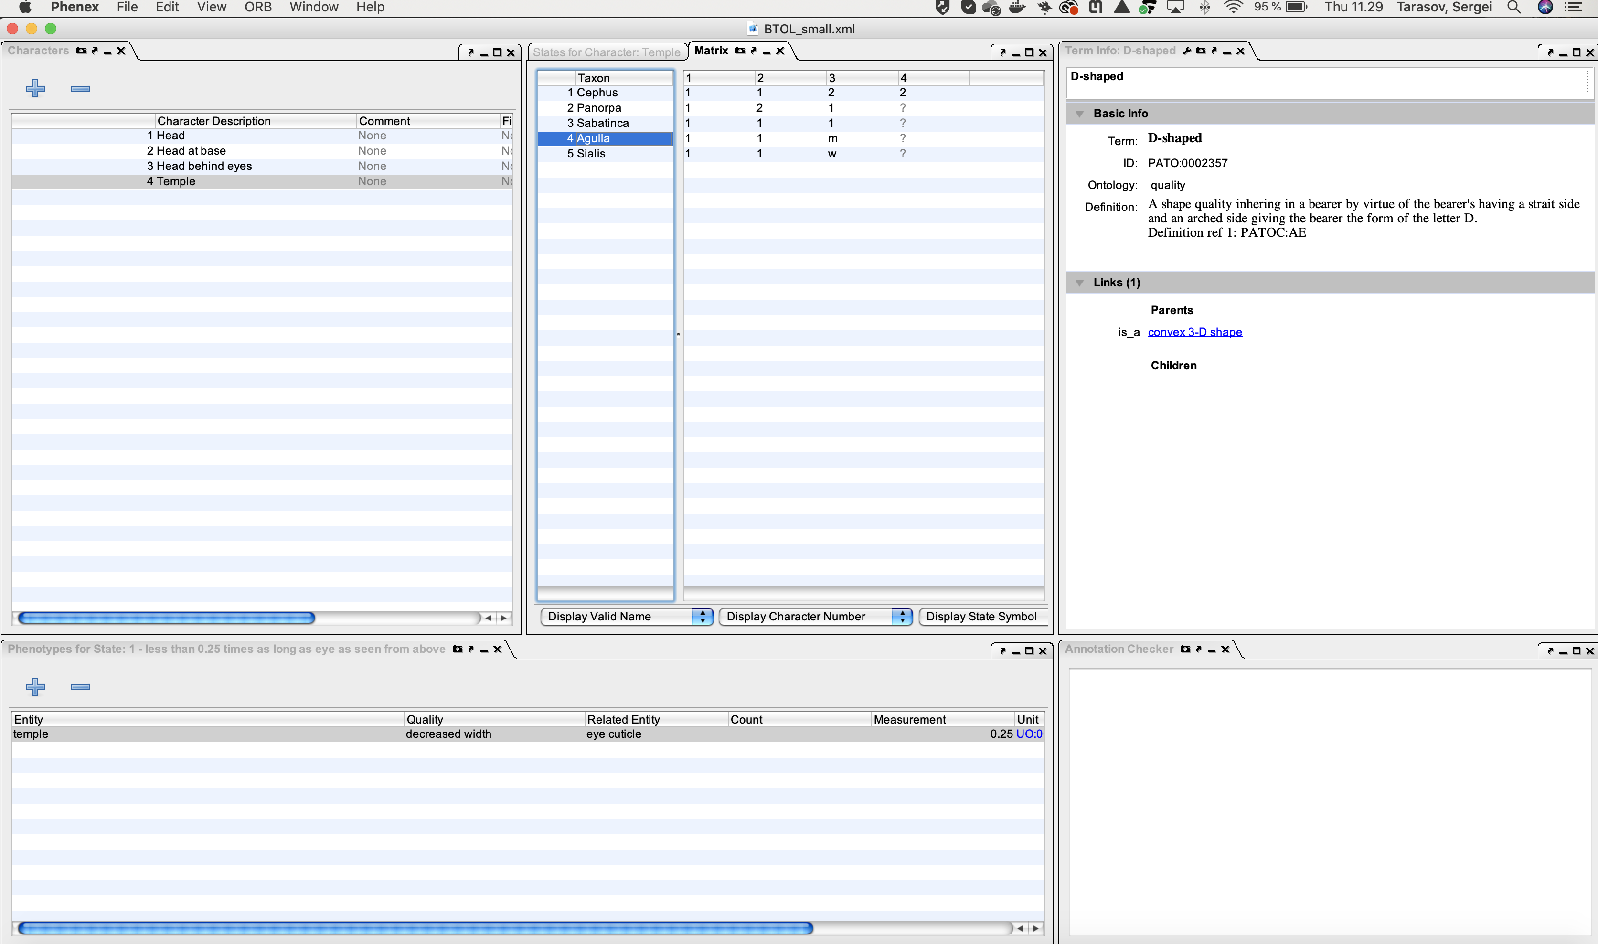
Phenex

Slide 4
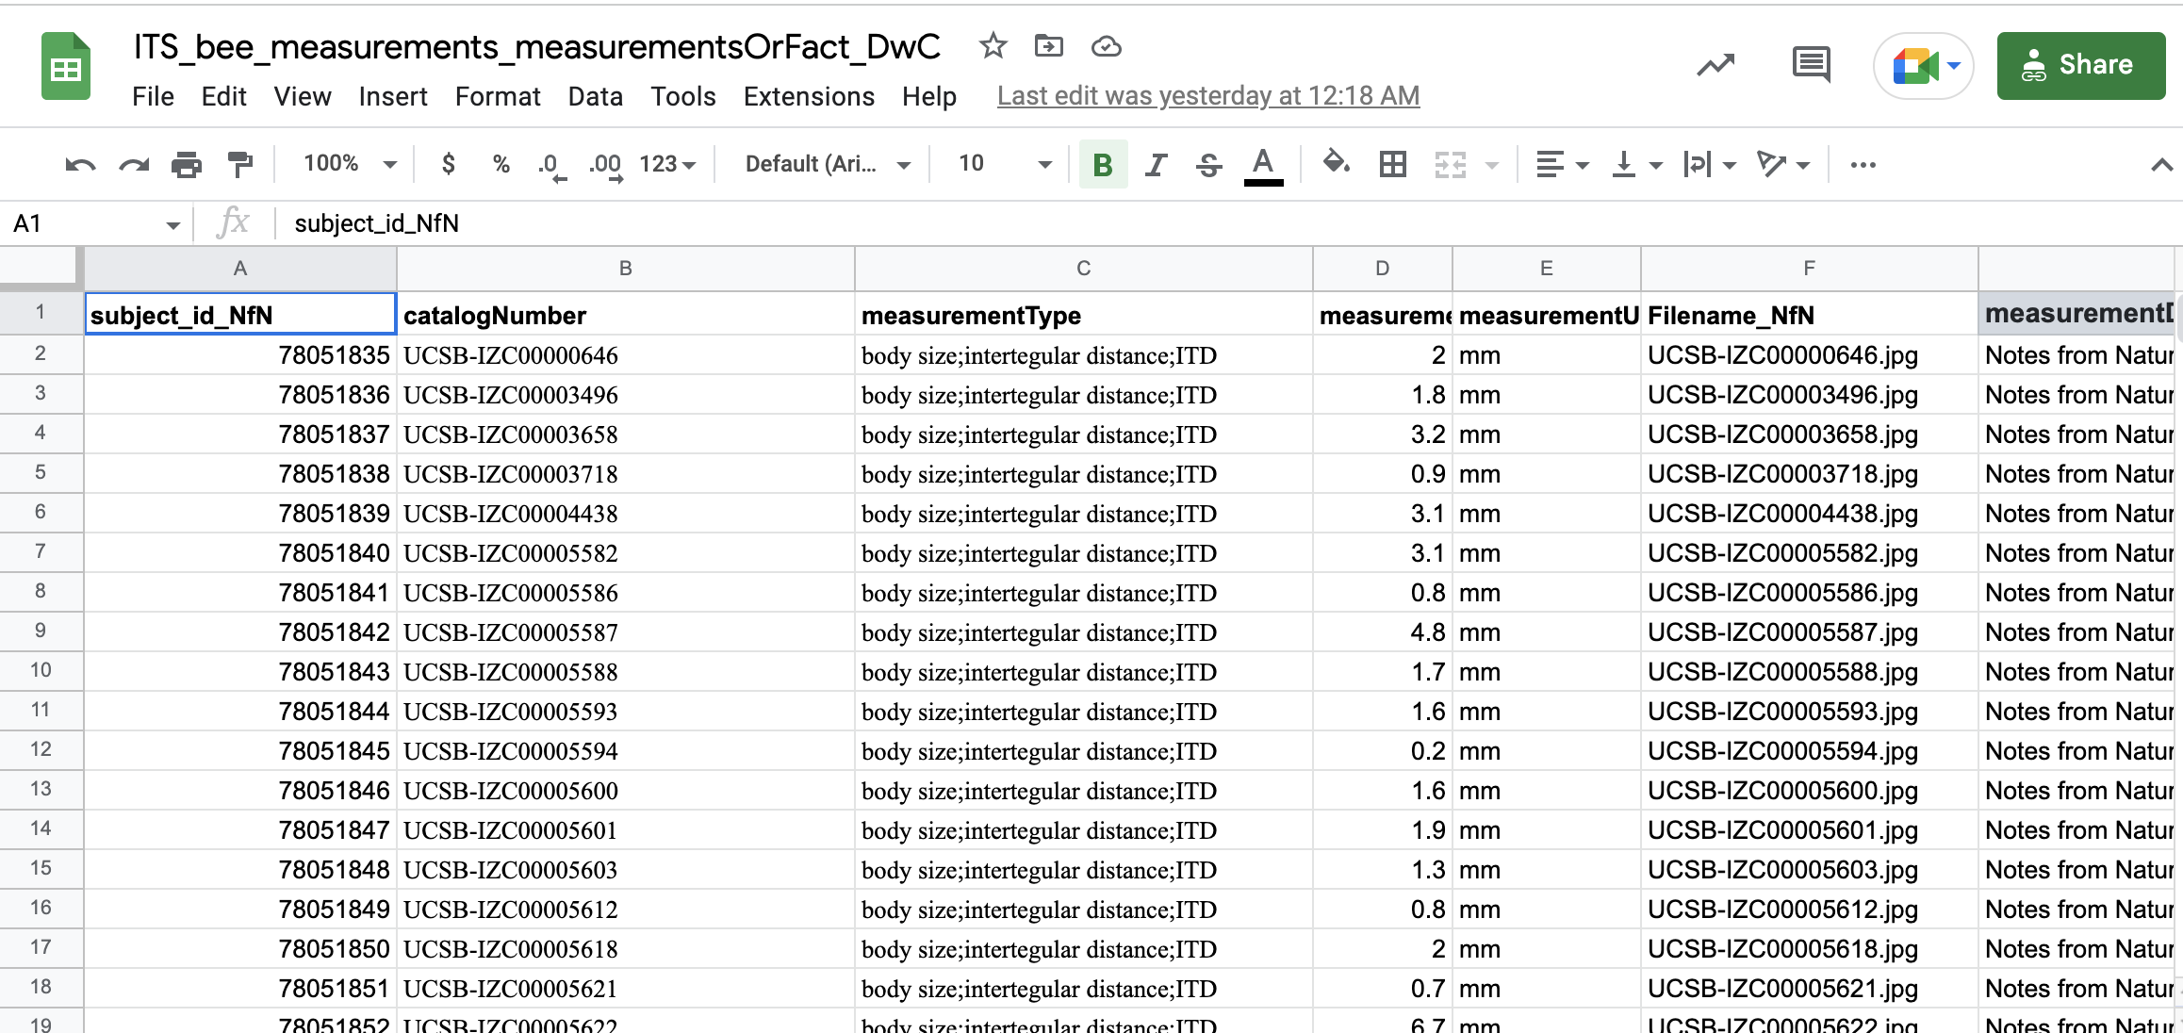
CSV

Slide 5
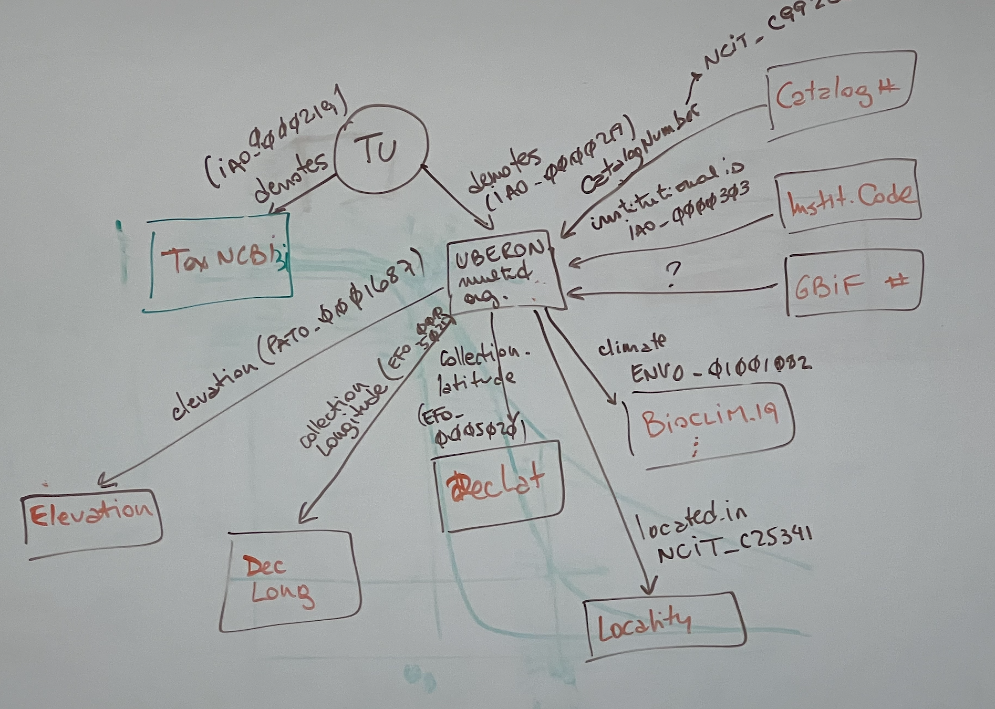
CSV

Slide 6
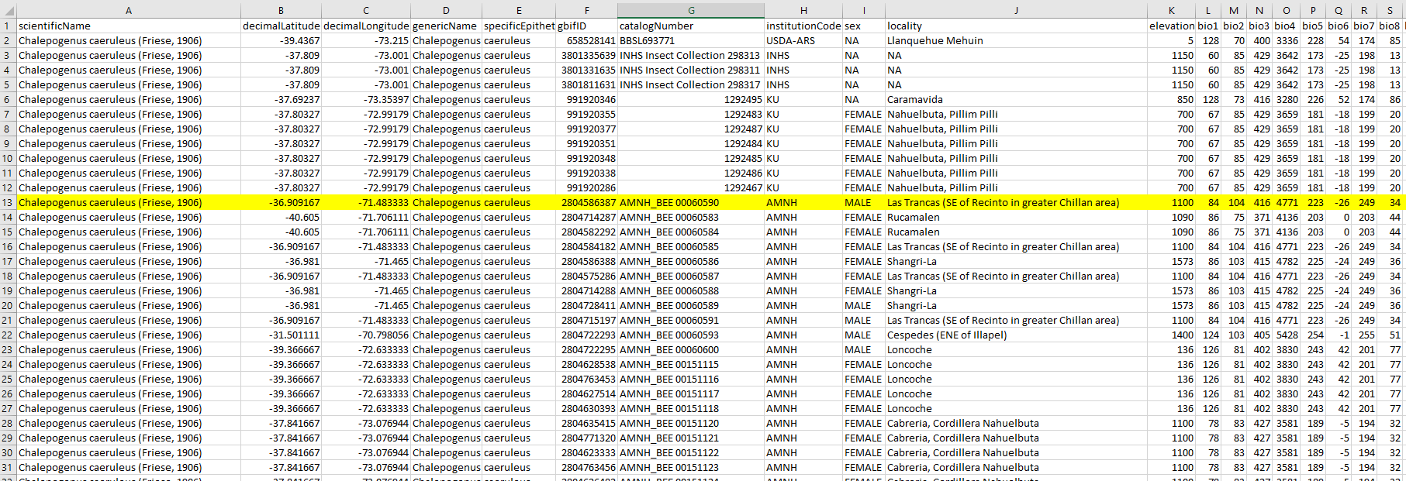
CSV

Slide 7
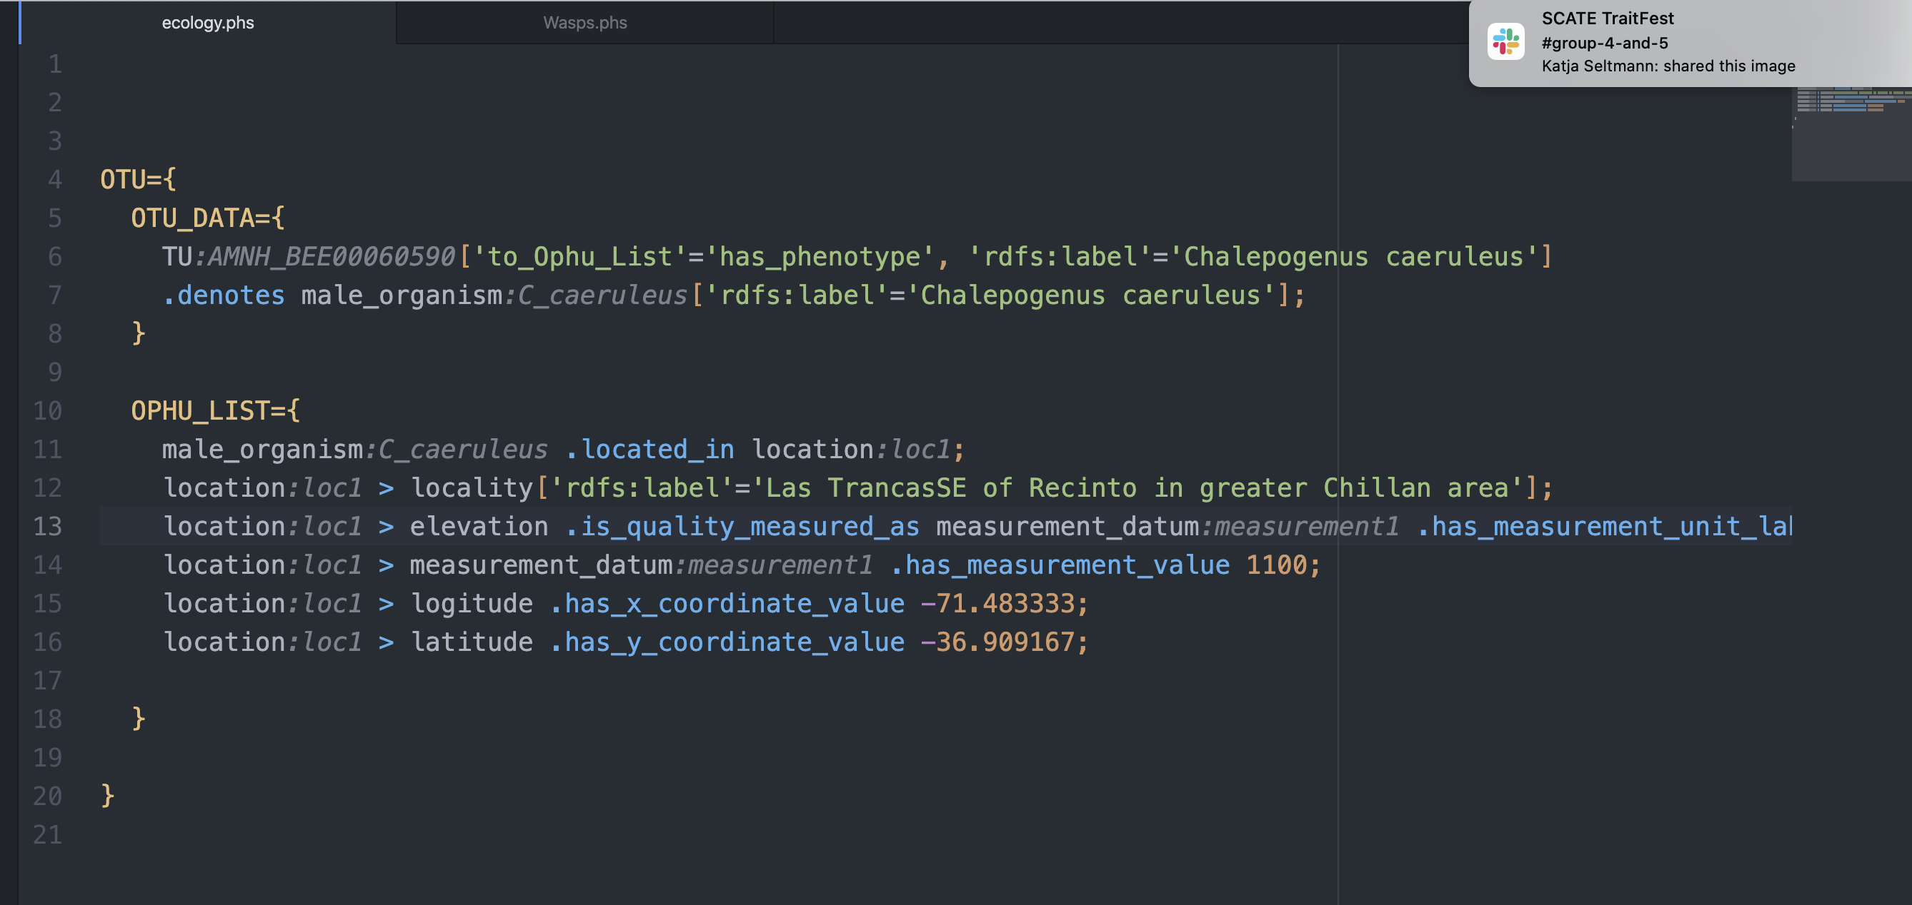
PhenoScript

